Slide 1

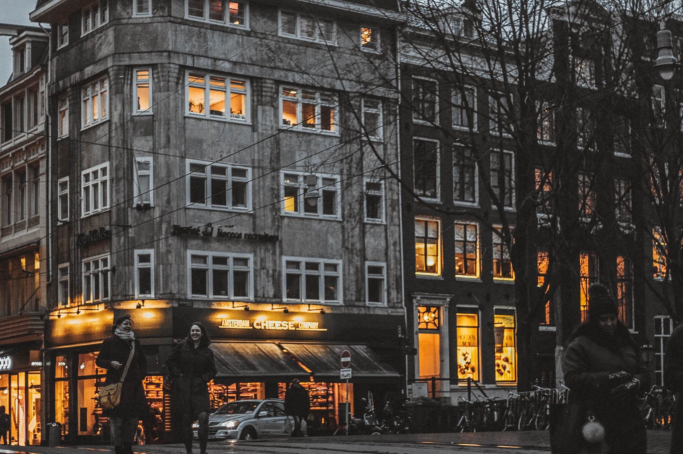
UNIT 3: VACATION
In your words

Slide 2

1. In your words

Slide 3

Talk about the things each person did and didn’t do in their last vacation.

Slide 4
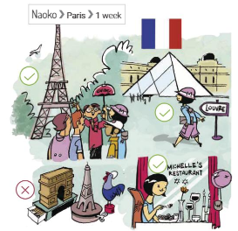
1. Where did she go?
2. How long did she stay?
3. What did she do?
4. What didn’t she do?

Slide 5
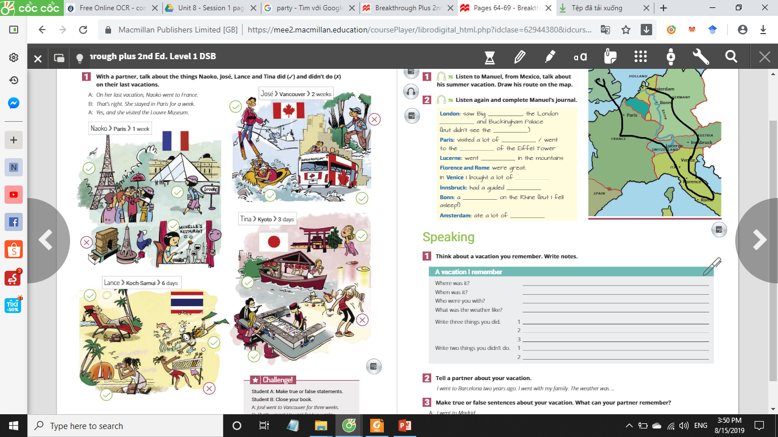
1. Where did he go?
2. How long did he stay?
3. What did he do?
4. What didn’t he do?

Slide 6
1. Where did he go?
2. How long did he stay?
3. What did he do?
4. What didn’t he do?

Slide 7
1. Where did she go?
2. How long did she stay?
3. What did she do?
4. What didn’t she do?

Slide 8
THANK YOU

